Slide 1

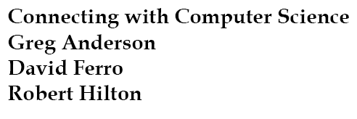
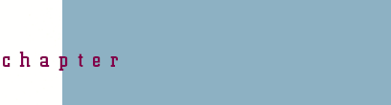


Slide 2
Objectives
Learn why numbering systems are important to understand
Refresh your knowledge of powers of numbers
Learn how numbering systems are used to count
Understand the significance of positional value in a numbering system
Learn the differences and similarities between numbering system bases
Connecting with Computer Science

Slide 3
Objectives (continued)
Learn how to convert numbers between bases
Learn how to do binary and hexadecimal math
Learn how data is represented as binary in the computer
Learn how images and sounds are stored in the computer
Connecting with Computer Science

Slide 4
Why You Need to Know About...
Numbering Systems
Computers store programs and data in binary code
Understanding of binary code is key to machine
Binary number system is point of departure
Hexadecimal number system
  Provides convenient representation
  Written into error messages
Connecting with Computer Science

Slide 5
Powers of Numbers - A Refresher
Raising a number to a positive power (exponent)
  Self-multiply the number by the specified power
  Example: 2³ = 2 * 2 * 2 = 8 (asterisk = multiplication)
  Special cases: 0 and 1 as powers
    Any number raised to 0 = 1; e.g, 10,555⁰ = 1.
    Any number raised to 1 = itself; e.g., 10,555¹ = 10,555
Connecting with Computer Science

Slide 6
Powers of Numbers -A Refresher (continued)
Raising a number to a negative power
  Follow same steps for positive power
  Divide result into 1; e.g., 2⁻³ = 1/ (2³) = .125
Connecting with Computer Science

Slide 7
Counting Things
Numbers are used to count things
  Base 10 (decimal) most familiar
The computer uses base 2, called binary
  Base 2 has two unique digits: 0 and 1
Connecting with Computer Science

Slide 8
Counting Things (continued)
Hexadecimal system used to represent binary digits
  Base 16 has sixteen unique digits: 0 – 9, A - F
Counting for all number systems similar
  Count digits defined in number system until exhausted
  Place zero in ones column. Carry one to the left
Connecting with Computer Science

Slide 9
Positional Value
Weight assigned digit based on position in number
  Determine positional value of each digit by raising 10 to position within number
  Determine digit’s contribution to overall number by multiplying digit by positional value
  Consider 5 in 3456.123 (radix = 10 = decimal point)
    Positional value = 10¹
    Overall contribution = 5 x 10¹ = 50
Connecting with Computer Science

Slide 10
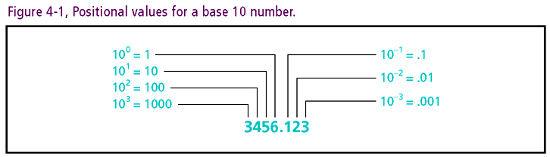
Connecting with Computer Science

Slide 11
Positional Value (continued)
Number: sum of products of each digit and positional value
  Example: 3456.123 = 3 x 10³ + 4 x 10² + 5 x 10¹ + 6 x 10⁰ + 1 x 10⁻¹ + 2 x 10⁻² + 3 x 10⁻³
Numbers in all bases can be defined by position
  Base 2: Multiply each digit by 2 ^{digit position}
  Base 16: Multiply each digit by 16 ^{digit position}
  Base b: Multiply each digit by b ^{digit position}
Connecting with Computer Science

Slide 12
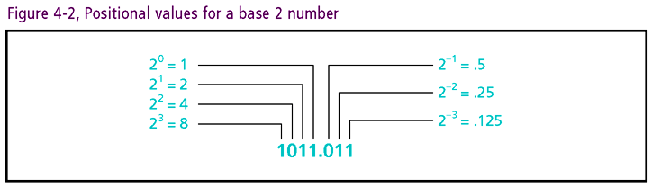
Connecting with Computer Science

Slide 13
How Many Things Does
A Number Represent
Number = sum of each digit x positional value
  Translate number of things to accord with base 10
  e.g.: 1001₂ is equivalent to nine things = (1 * 2⁰) + (0 * 2¹) + (0 * 2²) + (1 * 2³)
General procedure for evaluating numbers (any base)
  Calculate the value for each position of the number by raising the base value to the power of the position
  Multiply positional value by digit in that position
  Add each of the calculated values together
Connecting with Computer Science

Slide 14
Converting Numbers
Between Bases
Any quantity can be represented by some number in any base
Counting process similar for all bases
  Count until highest digit for base reached
  Add 1 to next higher position to left
  Return 0 to current position
Conversion is a map from one base to another
  Identities can be easily calculated
  Identities may also be obtained by table look-up
Connecting with Computer Science

Slide 15
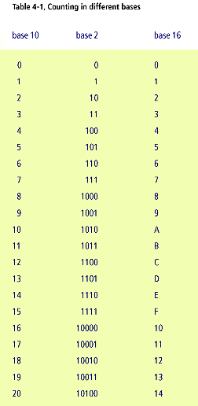
Connecting with Computer Science

Slide 16
Converting To Base 10
Three methods:
  Table look-up (more extensive than Table 4-1)
  Calculator
  Algorithm for evaluating number in any base
Example: consider 169AE in base 16
  Identify base: 16
  Map positions to digits: 4 3 2 1 0
  Raise, multiply and add: 169AE = (1 x 16⁴) + (6 x 16³) + (9 x 16²) + (10 x 16¹) + (14 x 16⁰) = 92,590
Connecting with Computer Science

Slide 17
Converting From Base 10
Three methods:
  Table look-up (more extensive than Table 4-1)
  Calculator
Connecting with Computer Science

Slide 18
Converting From Base 10 (continued)
  Algorithm for converting from base 10
    Divide the decimal number by the number of the target base (for example, 2 or 16)
    Write down the remainder
    Divide the quotient of the prior division by the base again
    Write the remainder to the left of the last remainder written
    Repeat Steps 3 and 4 until the whole number result is 0
Connecting with Computer Science

Slide 19
Converting From Base 10 (continued)
Practice conversion algorithm: find hexadecimal equivalent of decimal 45
  Divide 45 by 16 (base)
  Write down remainder D
  Divide 2 by 16
  Write down remainder 2 to the left of D (2D)
  Stop since reduced quotient = 0
  Check: 2D = (2 x 16¹) + (13 x 16⁰) = 32 + 13 = 45
Connecting with Computer Science

Slide 20
Binary And Hexadecimal Math
Procedure for adding numbers similar in all bases
  Difference lies in carry process
  Value of carry = value of base
  Example: 1011
  +1101
  11000
  Carry value for above = 10₂ = (1 x 10¹ + 0 x 10⁰ ) = 2₁₀
Procedure for subtraction, multiplication, and division also similar
Connecting with Computer Science

Slide 21
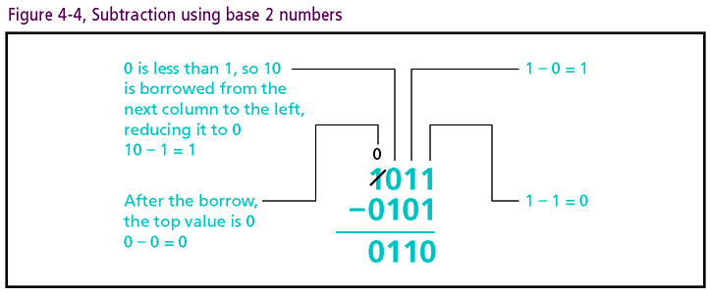
Connecting with Computer Science

Slide 22
Data Representation In Binary
Binary values map to two-state transistors
Bit: fundamental logical/physical unit (1/0 = on/off)
Byte: grouping of eight bits (nibble = ½ byte)
Word: collection of bytes (4 bytes is typical)
Hexadecimal used as binary shorthand
  Relate each hexadecimal digit to 4-bit binary pattern
  Example: 1111 1010 1100 1110 =
  F A C E (see Table 4-1)
Connecting with Computer Science

Slide 23
Representing Whole Numbers
Whole numbers stored in fixed number of bits
  2004₁₀ stored as 16-bit integer 0000011111010100
Signed numbers stored with two’s complement
  Left most bit reserved for sign (1 = neg and 0 = pos)
  If positive, store with leading zeroes to fit field
  If negative, perform two’s complement
    Reverse bit pattern
    Add 1 to number using binary addition
Connecting with Computer Science

Slide 24
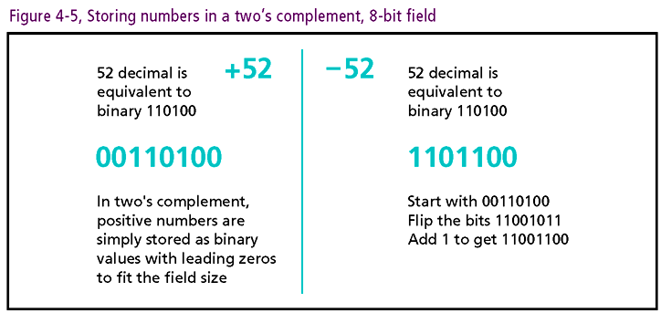
Connecting with Computer Science

Slide 25
Representing Fractional Numbers
Computers store fractional numbers (neg and pos)
Storage technique based on floating-point notation
  Example of floating point number: 1.345 E+5
  1.345 = mantissa, E = exponent, + 5 moves decimal
IEEE-754 specification uses binary mantissas and exponents
Implementation details part of advanced study
Connecting with Computer Science

Slide 26
Representing Characters
Computers store characters according to standards
ASCII
  Represents characters with 7-bit pattern
  Provides for upper and lowercase English letters, numeric characters, punctuation, special characters
  Accommodates 128 (2⁷) different characters
Globalization places upward pressure
  Extended ASCII: allows 8-bit patterns (256 total)
  Unicode: defined for 16 bit patterns (34,168 total)
Connecting with Computer Science

Slide 27
Representing Images
Screen image made up of small dots of colored light
  Dot called “pixel” (picture element), smallest unit
  Resolution: # pixels in each row and column
  Each pixel is stored in the computer as a binary pattern
RGB encoding
  Red, blue, and green assigned to eight of 24 bits
  White represented with 1s, black with 0s
  Color is the amount of red, green, and blue specified in each of the 8-bit sections
Connecting with Computer Science

Slide 28
Representing Images (continued)
Images, such as photos, stored with pixel-based technologies
Large image files can be compressed (JPG, GIF formats)
Moving images can also be compressed (MPEG, MOV, WMV)
Connecting with Computer Science

Slide 29
Representing Sounds
Sound represented as waveform with
  Amplitude (volume) and
  Frequency (pitch)
Computer samples sounds at fixed intervals
  Samples given a binary value according to amplitude
  # bits in each sample determines amplitude range
  For CD-quality audio
    Sound must be sampled over 44,000 times a second
    Samples must allow > 65,000 different amplitudes
Connecting with Computer Science

Slide 30
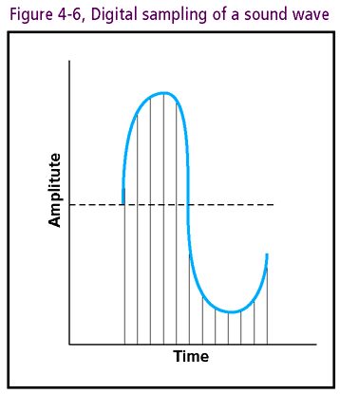
Connecting with Computer Science

Slide 31
One Last Thought
Binary code is the language of the machine
Knowledge of base 2 and base 16 prerequisite to knowledge of machine language
Computer scientists are more effective with binary and hexadecimal concepts
Connecting with Computer Science

Slide 32
Summary
Knowledge of alternative number systems essential
Machine language based on binary system
Hexadecimal used to represent binary numbers
Power rule for numbers defines self-multiplication
Any number can be represented in any base
Connecting with Computer Science

Slide 33
Summary (continued)
Positional value: weight based on digit position
Counting processes similar for all bases
Conversion between bases is one-to-one mapping
Arithmetic defined for all bases
Data representation: bits, nibbles, bytes, words
Connecting with Computer Science

Slide 34
Summary (continued)
Two’s complement: technique for storing signed numbers
Floating point notation: system used to represent fractions and irrationals
ASCII and Unicode: character set standards
Image representation: based on binary pixel
Sound representation: based on amplitude samples
Connecting with Computer Science

